Slide 1
Decision Trees
CSCI 111

Slide 2
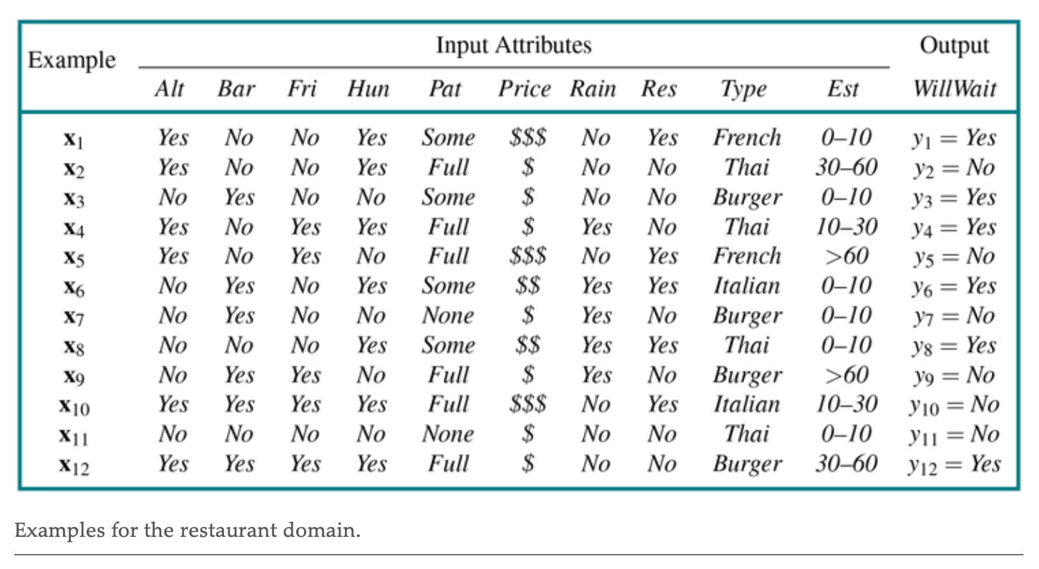
Restaurant Waiting

Slide 3
Restaurant Waiting
FEATURES
LABELS
Given a set of factors (features), will we wait for a table?
Blue: Yes (they waited)
Red: No (they did not wait)
Patrons | Hungry | Type | … | Friday
Some | Yes | French |  | No
Full | Yes | Thai |  | No
Some | No | Burger |  | No
Full | Yes | Thai |  | Yes
Full | No | French |  | Yes
Will Wait
Yes
No
Yes
Yes
No
1
2
3
4
YES
NO
5
. . .
. . .
Examples of scenarios and corresponding decisions

Slide 4
Restaurant Waiting
Goal:
Given a new scenario (set of features), predict whether they’ll wait or not
using a classification model
NEW DATA
LABEL: WILL WAIT?
Hungry | Patron | … | Type
Yes | Some |  | Italian
YES
NO
OR

Slide 5
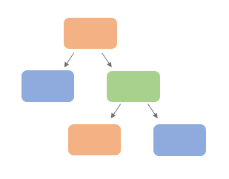
Classification: Decision Tree
Review: a classifier learns a function from a labeled dataset
A decision tree classifier encodes this function as a sequence of decisions or tests
TRAINED CLASSIFICATION MODEL
y = f(X₁, X₂, X₃,… X_{m})

Slide 6
Classification: Decision Tree
FEATURES
LABELS
MODEL
(UNTRAINED)
TRAINING SET:
Scenarios and corresponding decisions to wait or not

Slide 7
Classification: Decision Tree
FEATURES
LABELS
MODEL
(TRAINED)
TRAINING SET:
Scenarios and corresponding decisions to wait or not

Slide 8
Classification: Decision Tree
TEST FEATURES
PREDICTED LABELS
TRAINED MODEL
y = f(X₁, X₂, X₃,… X_{m})
X₁ | X₂ | X₃
y
Predicted decisions to wait or not
New scenarios

Slide 9
Classification: Decision Tree
TRAINED MODEL
y = f(X₁, X₂, X₃,… X_{m})
Decision tree based on scenarios and corresponding decisions (training set)

Slide 10
Classification: Decision Tree
TEST FEATURES
PREDICTED LABELS
X₁ | X₂ | X₃
y
Predicted decisions to wait or not
New scenarios

Slide 11
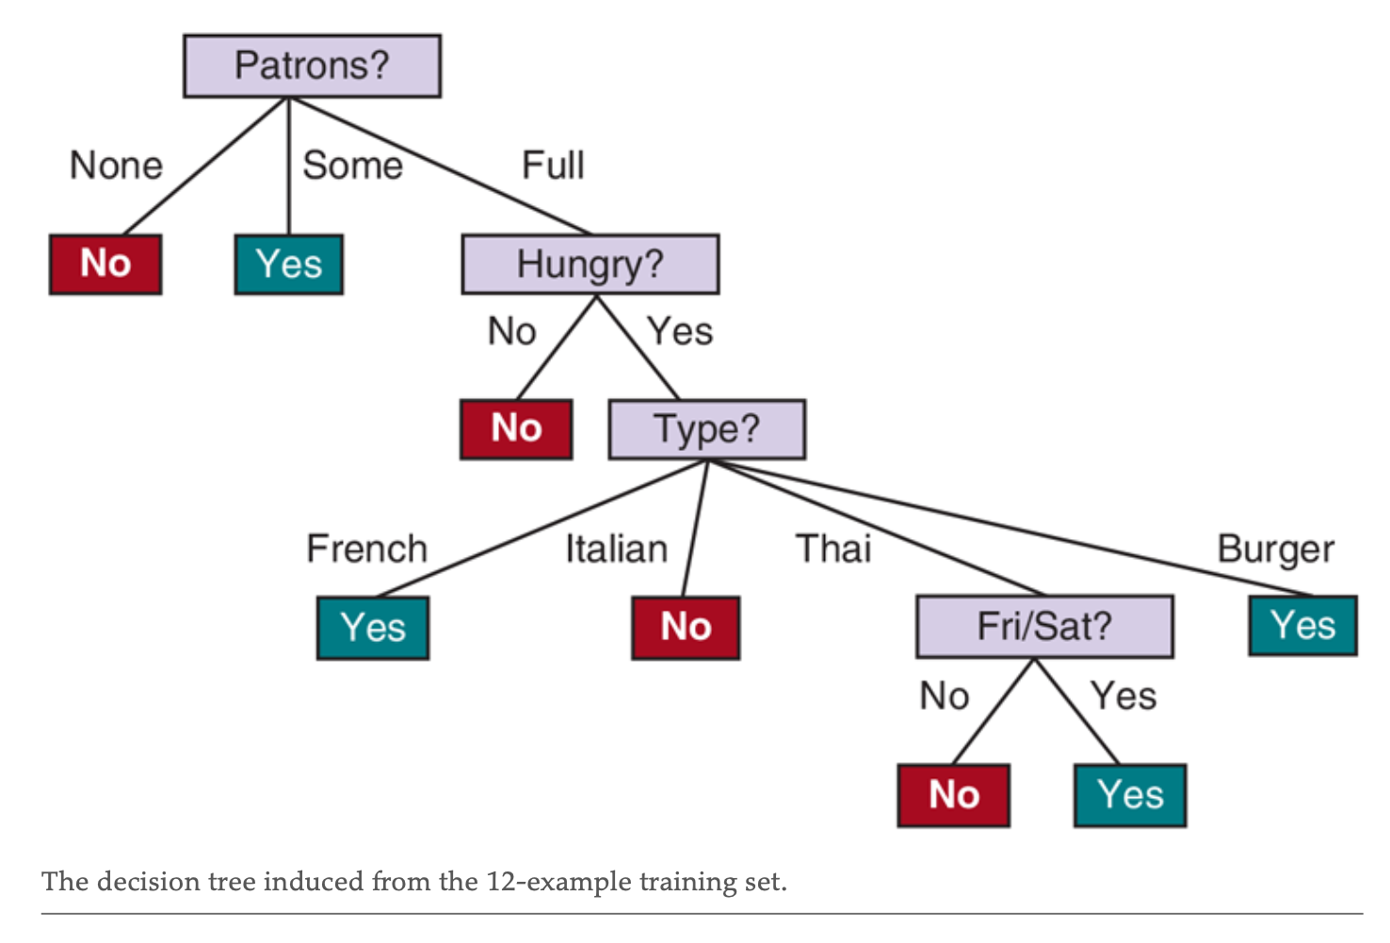
Classification: Decision Tree

Slide 12
What’s a tree (in graph theory)
Hierarchical structure
made up of nodes
linked by parent-child (branch) relationships
Terms:
Root: first node
Branch
Leaf: terminal node
ROOT
NODE
branches
LEAF
LEAF
NODE
branches
LEAF
LEAF

Slide 13
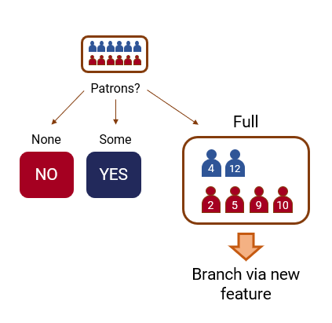
What’s a decision tree
A sequence of tests (decisions) induced from a dataset
Each test is based on a single feature
Eventually leads to a predicted label

Slide 14
What’s a decision tree
Features as decision nodes
Feature values as branches
a split based on result of decision
Leaf/terminal nodes as labels or classes
DECISION
NODE
Feature
Feature values
LABEL
LABEL
DECISION
NODE
Feature
Feature values
LABEL
LABEL

Slide 15
Classification: Decision Tree
DECISION NODES:
FEATURES

Slide 16
Classification: Decision Tree
BRANCHES:
FEATURE VALUES

Slide 17
Classification: Decision Tree
TERMINAL NODES:
LABELS/CLASSES

Slide 18
Decision Tree Application
NEW DATA
LABEL: WILL WAIT?
Hungry | Patron | … | Type
Yes | Full |  | Italian
YES
NO
OR

Slide 19
Decision Tree Application
NEW DATA
Hungry | Patron | … | Type
Yes | Full |  | Italian

Slide 20
Decision Tree Application
NEW DATA
Hungry | Patron | … | Type
Yes | Full |  | Italian

Slide 21
Decision Tree Application
NEW DATA
Hungry | Patron | … | Type
Yes | Full |  | Italian

Slide 22
Decision Tree Application
NEW DATA
Hungry | Patron | … | Type
Yes | Full |  | Italian
REACHED TERMINAL NODE
LABEL: NO

Slide 23
Decision Tree Application
PREDICTED LABEL:
WILL WAIT?
NEW DATA
NO
Hungry | Patron | … | Type
Yes | Full |  | Italian

Slide 24
Decision Tree Induction

Slide 25
Decision Tree Induction
Starts with the entire dataset
Instances are split into nodes according to feature values
A split represents a decision node in the tree
1
3
4
6
8
12
2
5
7
9
10
11
Patrons?
None
Some
Full
1
3
6
8
4
12
7
11
2
5
9
10

Slide 26
Decision Tree Induction
Instances “trickle down” until:
homogeneity is achieved,
all features have been used, or
instances in a node are lower than a threshold

Slide 27
Decision Tree Induction
Greedy algorithm:
To make a tree: determine the best attribute to split at every level
Patrons
Feature ?
?
?
Feature ?
?
?

Slide 28
Decision Tree Induction
Greedy algorithm:
To make a tree: determine the best attribute to split at every level
Patrons
Patrons
Hungry
Feature ?
?
?
Feature ?
Next level…

Slide 29
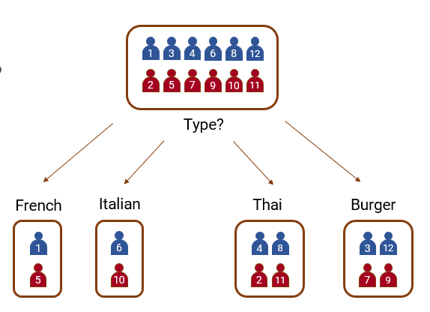
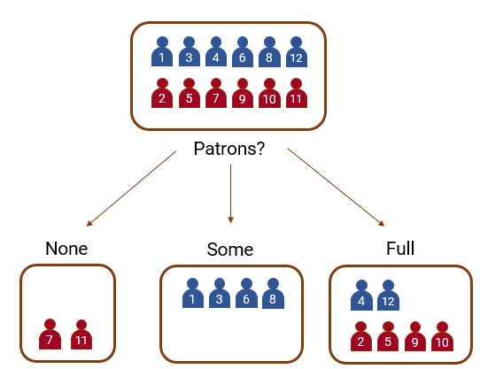
Decision Tree Induction
“Best Split”
Attributes that separate the data best are more important
Homogenous examples are preferred
VS

Slide 30
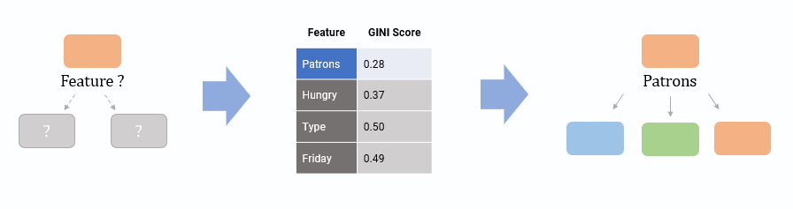
Decision Tree Induction
“Best Split”
Score how well an attribute splits examples, then select attribute with the best score

Slide 31
Decision Tree Induction
When inducing/making a decision tree, we consider:
Splitting: How to branch out an attribute
Nominal
Ordinal
Numeric
Scoring splits: Which feature/attribute to split

Slide 32
Splitting by Attribute

Slide 33
Splitting
There are multiple ways to split a feature/attribute
Especially for numeric values
Budget
Budget
VS
value < 1k
1k ≤ value < 10k
15k ≤ value
value < 8k
8k ≤ value

Slide 34
Splitting Based on Attribute Type
Nominal
no specific order or numerical value (e.g. gender, color)
Ordinal
with a natural order or ranking (e.g. education levels)
Continuous/numeric
numerical data that can take any value (e.g. temperature)

Slide 35
Splitting Nominal Attributes
Nominal
Categories with no specific order or numerical value (e.g. gender, color)
Possible Splits:
Multi-way split
Binary split

Slide 36
Splitting Nominal Attributes
Multi-way split
Use as many partitions as distinct values
Example: Car Type
Family
Sport
Luxury
Car Type
Family
Sports
Luxury

Slide 37
Splitting Nominal Attributes
Binary split
Divides values into two subsets
Requires finding the optimal partitioning
Car Type
{Sports, Luxury}
{Family}

Slide 38
Splitting Nominal Attributes
Binary split
Divides values into two subsets
Requires finding the optimal partitioning
Car Type
{Family, Luxury}
{Sports}

Slide 39
Splitting Ordinal Attributes
Ordinal
Categories with a natural order or ranking (e.g. education level, patrons)
Possible Splits:
Multi-way split
Binary split

Slide 40
Splitting Ordinal Attributes
Multi-way split
Use as many partitions as distinct values
Example: Size
Small
Medium
Large
Size
Small
Medium
Large

Slide 41
Splitting Ordinal Attributes
Binary split
Divides values into two subsets
Requires finding the optimal partitioning
Size
{Small, Medium}
{Large}

Slide 42
Splitting Ordinal Attributes
Binary split
Divides values into two subsets
Requires finding the optimal partitioning
Size
{Small}
{Medium, Large}

Slide 43
Splitting Ordinal Attributes
Binary split
Divides values into two subsets
Requires finding the optimal partitioning
Size
{Small, Large}
{Medium}
Does this make sense?

Slide 44
Splitting Continuous Attributes
Continuous/Numeric
Numerical data that can take any value (e.g. height, temperature)
Possible Splits:
Discretization
Binary Decision

Slide 45
Splitting Continuous Attributes
Discretization (Multi-way)
Form an ordinal categorical attribute
Bucketing, percentiles, clustering
Taxable Income
< 10k
[10k, 80k)
80k ≤

Slide 46
Splitting Continuous Attributes
Binary Decision
Consider all possible splits and find best cut
Can be more compute intensive
Taxable Income
< 80k
80k ≤

Slide 47
Best Split via Scoring
Sometimes use a scoring method to determine best binary split or thresholds
Car Type
Binary Split | Score
{Sports} and {Luxury, Family}
{Luxury} and {Sports, Family}
{Family} and {Sports, Luxury}
{Subset}
{Subset}

Slide 48
Best Split via Scoring
Sometimes use a scoring method to determine best binary split or thresholds
Taxable Income
Threshold | Score
10k
20k
30k
…
< threshold
threshold ≤

Slide 49
Scoring Splits

Slide 50
Decision Tree

Slide 51
Choosing the Feature
Patrons?
None
Some
Full
Why did we start with the Patrons feature for branching instead of other features?

Slide 52
Choosing the Feature
And how will we choose which feature to branch/split next?

Slide 53
Decision Tree
Which feature do we split?
The feature that can best distinguish examples by their labels
1
3
4
6
8
12
2
5
7
9
10
11
Type?
French
Italian
Thai
Burger
1
6
4
8
3
12
5
10
2
11
7
9
Same number of “Yes” and “No” per group: bad

Slide 54
Scoring splits
Best split:
Nodes with homogeneous class distributions are preferred
Homogeneous: when examples in a node tend to be in one class/label
Finding best split by measuring node impurity

Slide 55
Node Impurity
YES
NO
Labels/Classes:
(Yes: 4, No: 0)
Homogeneous:
Pure
(Yes: 1, No: 4)
Non-homogeneous:
Low impurity
(Yes: 2, No: 2)
Non-homogeneous:
High impurity

Slide 56
Node Impurity
Different measures for node impurity
Gini index
Entropy
Misclassification error
All these measures help determine most important attributes that:
Separate examples best
Provide the most homogeneity for the tree

Slide 57
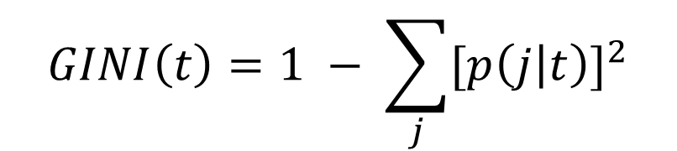
GINI Index
Measure of Impurity: GINI
t : node (e.g. the category like none/some/full for Patrons)
j : class (e.g. the label like Yes/No for Will Wait)
p ( j | t ) : relative frequency of the class in the group
$$GINI\left(t\right)=1 − \sum_{j}{{[p\left(j | t\right)]}^{2}}$$

Slide 58

DECISION TREE
GINI INDEX FOR A FEATURE
F
a
GINI(a)
$GINI(a)\left(\frac{\# in a}{total \#}\right)$ + $GINI(b)\left(\frac{\# in b}{total \#}\right)$
a
b
b
GINI(b)
PICK A FEATURE AND SPLIT
COMPUTE GINI INDEX FOR EACH NODE
GET THE WEIGHTED AVERAGE

Slide 59
DECISION TREE
BRANCHING
FEATURE | GINI SCORE
Hungry | 0.37
Patrons | 0.28
Type | 0.50
Friday | 0.49
Feature?
Patrons
?
?
FIND FEATURE WITH THE SMALLEST GINI SCORE
SPLIT/BRANCH ACCORDING TO THAT FEATURE

Slide 60
Summary

Slide 61
Classification: Decision Tree
A decision tree classifier encodes a function for the dataset as a sequence of decisions or tests
Each test is based on a single feature
Eventually leads to a predicted label
TRAINED CLASSIFICATION MODEL
y = f(X₁, X₂, X₃,… X_{m})

Slide 62
Classification: Decision Tree
FEATURES
LABELS
TRAINED MODEL
TRAINING SET:
Scenarios and corresponding decisions to wait or not

Slide 63
Classification: Decision Tree
TRAINED MODEL
y = f(X₁, X₂, X₃,… X_{m})
Decision tree based on scenarios and corresponding decisions (training set)

Slide 64
Classification: Decision Tree
TEST FEATURES
PREDICTED LABELS
X₁ | X₂ | X₃
y
Predicted decisions to wait or not
New scenarios

Slide 65

Restaurant Waiting
Given a new scenario (set of features), predict whether they’ll wait or not
using a decision tree
LABEL: WILL WAIT?
NEW DATA
Hungry | Patron | … | Type
Yes | Some |  | Italian

Slide 66
Decision Tree Induction
To make a tree: determine the best feature to split at every level based on node homogeneity/purity
Patrons
Feature ?
?
?
Feature ?
?
?
Next level…

Slide 67
Decision Tree: Advantages
Easy to understand/interpret
Minimal data preparation
Normalization not needed
Can handle numeric and categorical data
Easier to handle missing data

Slide 68
Decision Tree: Advantages
Relatively fast for both induction and application
Induction: making a decision tree from a dataset
Application: using a decision tree to arrive at a predicted label

Slide 69
Decision Tree
Hierarchical structure: Tree
Nodes → features
Branches → feature values
Leaf → labels/classes
Inducing Tree:
Selecting attributes of highest importance (homogeneity/purity)
Splitting attribute on type
Flexible, fast, and interpretable

